Slide 1
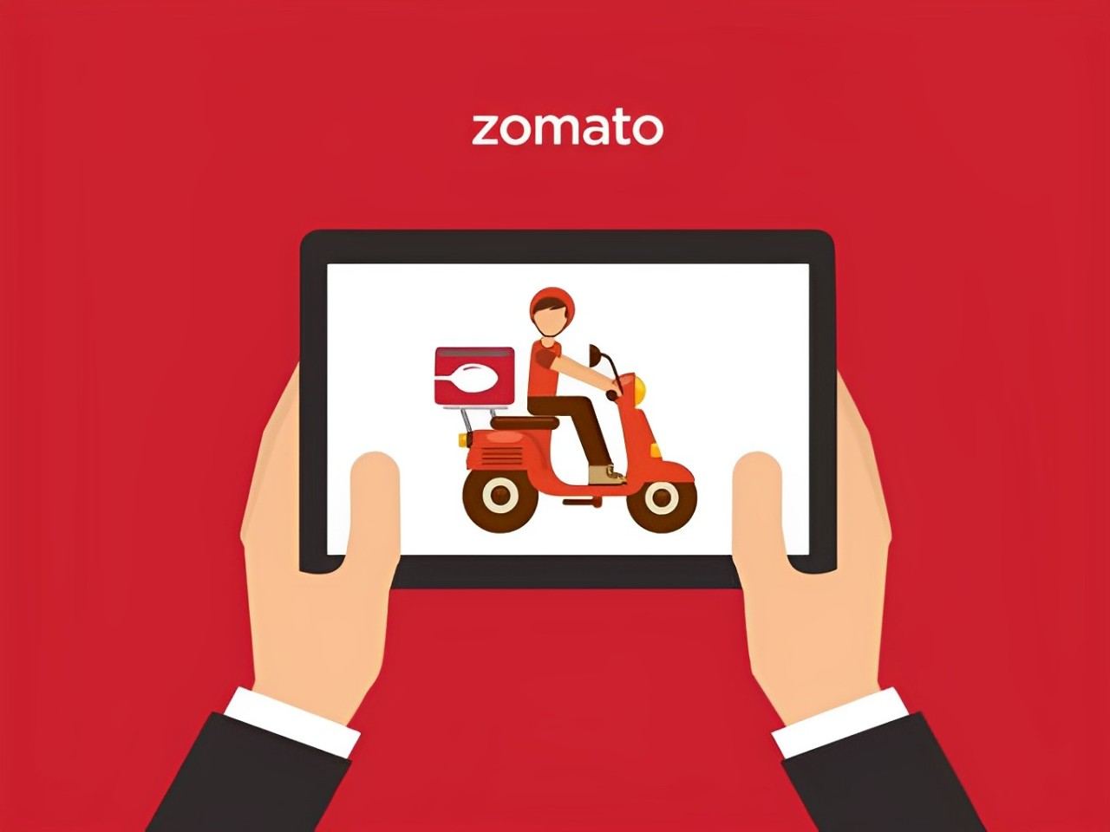
ZOMATO FOOD DELIVERY ANALYSIS
Krishan Kant cds01_051
Aman Kumar cds01_029
Harsha Budhabaware cds01_037
Deepak Kumar cds01_015
Dharti Shirodkar cds01_024

Slide 2
INTRODUCTION
Our analysis delves into a comprehensive dataset capturing Bangalore's food delivery scene. We've analyzed a rich dataset to uncover trends shaping this dynamic landscape. Our focus is on revealing insights into restaurant distribution, pricing strategies, and consumer preferences to drive actionable decisions. Whether you're a restaurant owner seeking revenue optimization or a delivery platform aiming to improve service and marketing, our findings aim to empower you for success in the food delivery ecosystem

Slide 3
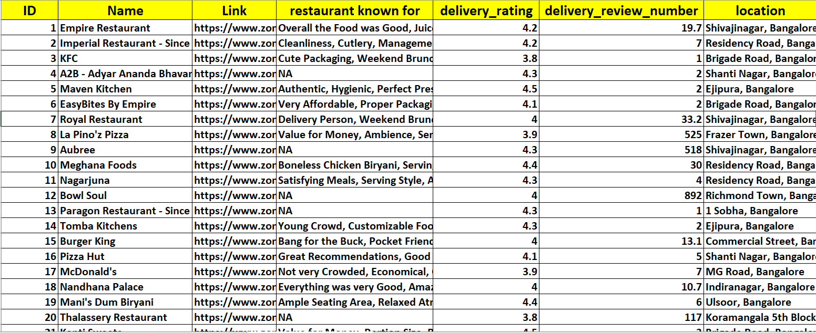
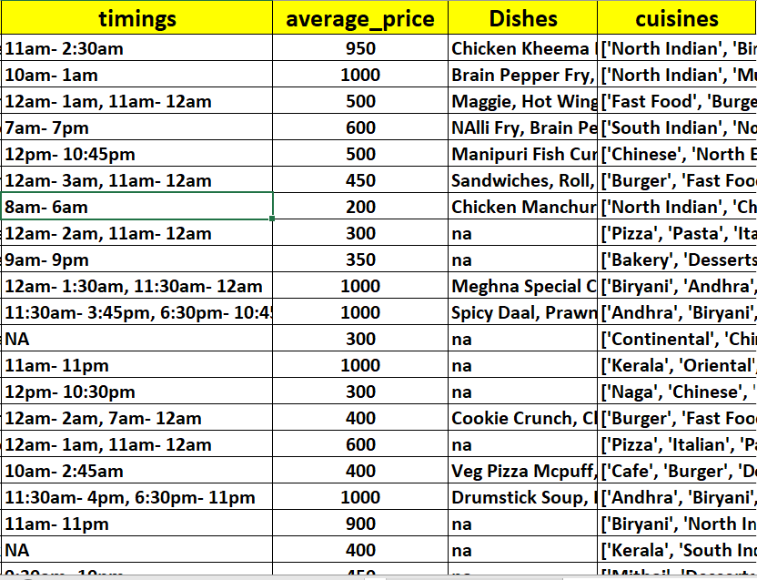
Data Set Overview

Slide 4
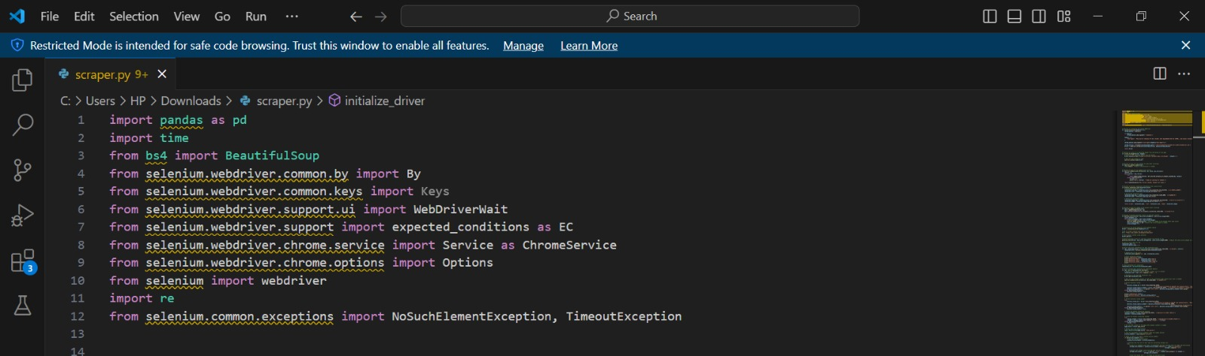
Project Methodology
Web Scrapping
1.Initialize WebDriver
2.Fetch Dynamic Content
3.Perform Scrolling
4.Extract Restaurant Information
5.Extract Additional Details
6.Data Storage
7.Save Data to CSV

Slide 5
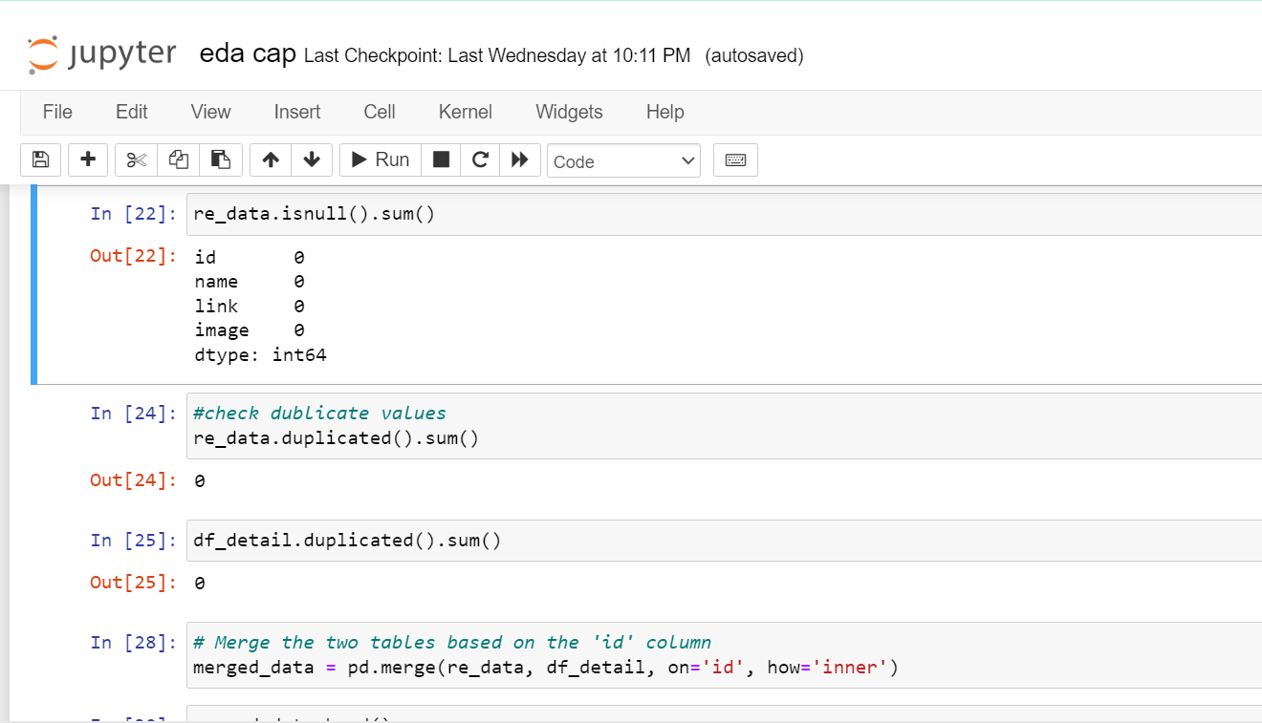
Project Methodology
EDA using Python
1.Data Loading
2.Data Cleaning
3.Data Exploration
4.Data Visualization
5.Insight Generation
This EDA process helps us gain a deeper understanding of the dataset, uncover patterns, and extract meaningful insights that can drive informed decisions and strategies.

Slide 6
Project Methodology
Excel
1.Dynamic Excel Dashboard Creation
2.Useful Insights
3.Slicers and Interactivity
4.User-Friendly Interface
5.Dynamic Data Refresh
The Excel dashboard serves as a powerful tool for visualizing and analyzing the insights derived from the food delivery data, empowering stakeholders to make informed decisions and strategize effectively

Slide 7
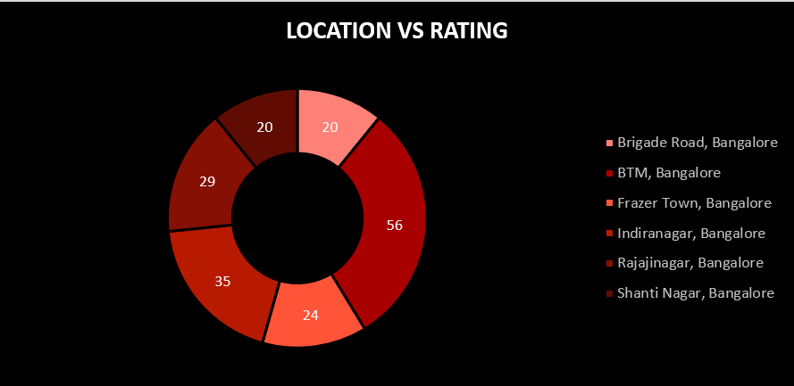
Project Insights
LOCATION WITH MAX NO. OF LESS RATED RESTAURANTS

Slide 8
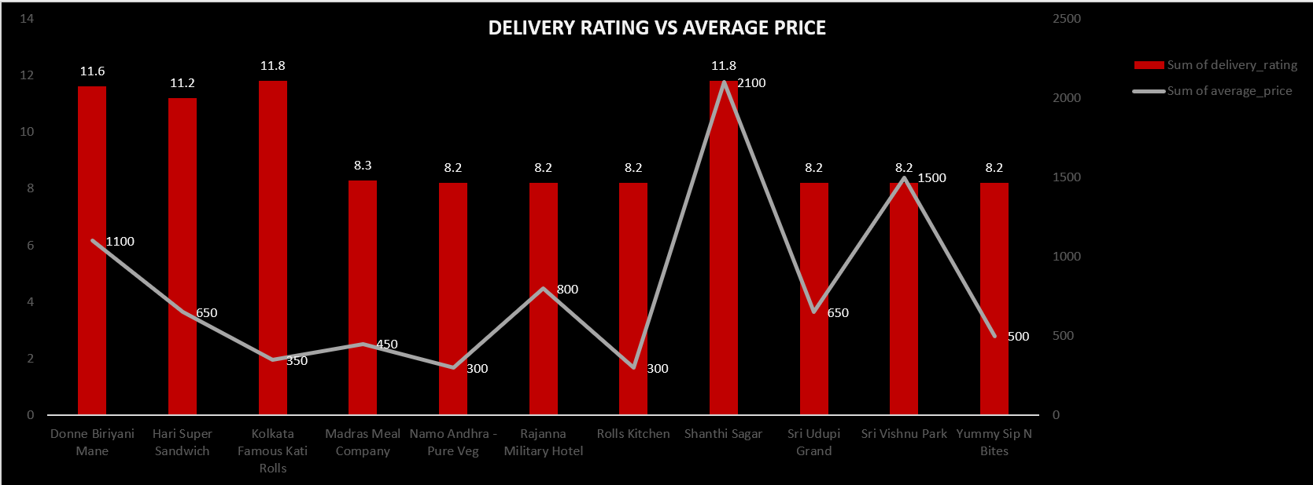
Project Insights
DELIVERY RATING VS AVERAGE PRICE

Slide 9
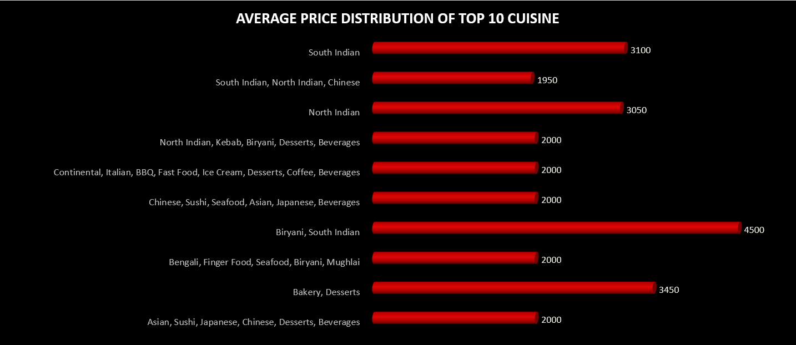
Project Insights
AVERAGE PRICE DISTRIBUTION OF TOP TEN CUISINE

Slide 10
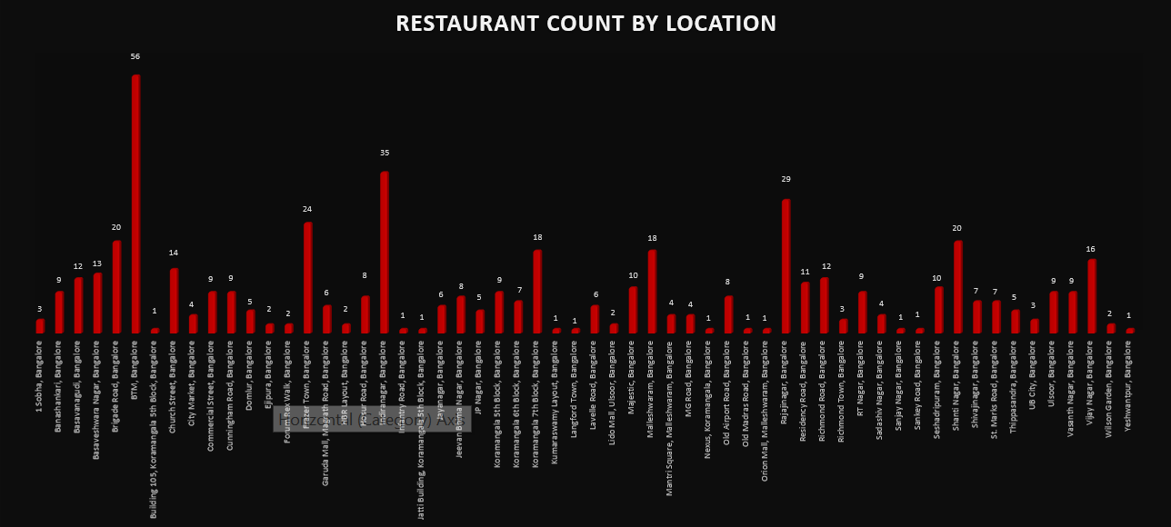
Project Insights

Slide 11
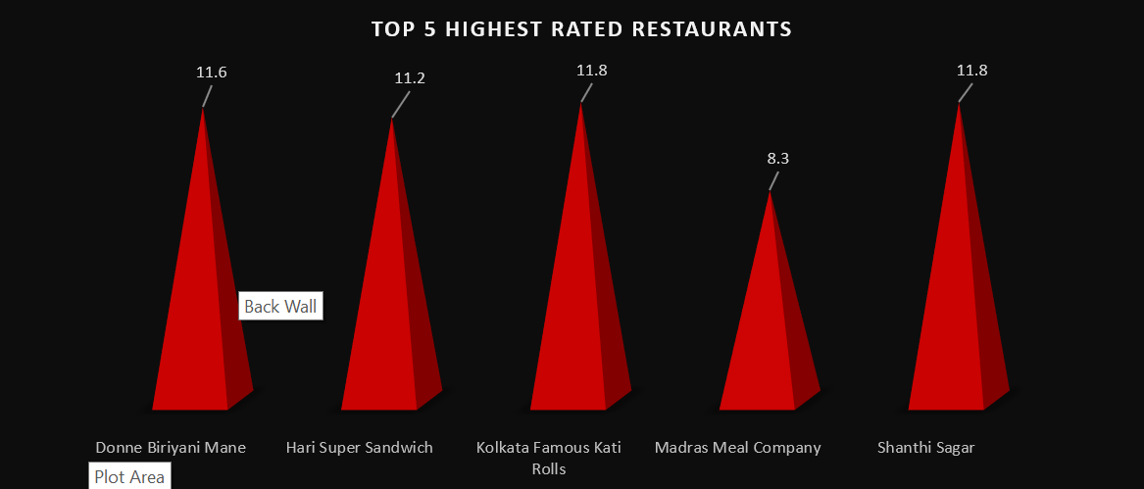
Project Insights
TOP 5 HIGHEST RATED RESTAURANTS

Slide 12
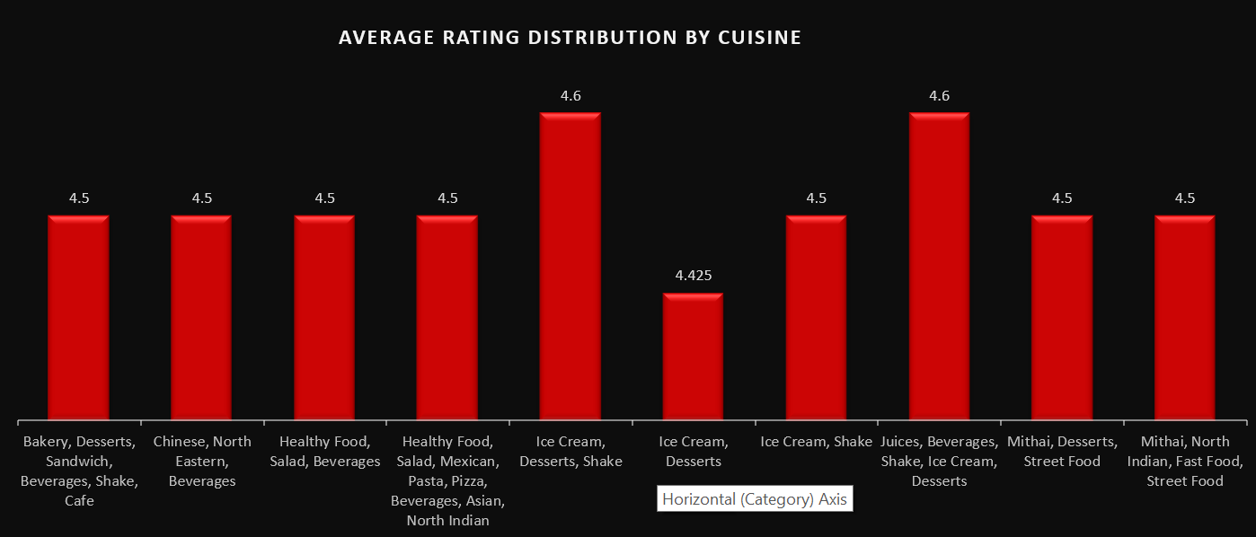
Project Insights
AVERAGE OF DELIVERY RATING

Slide 13
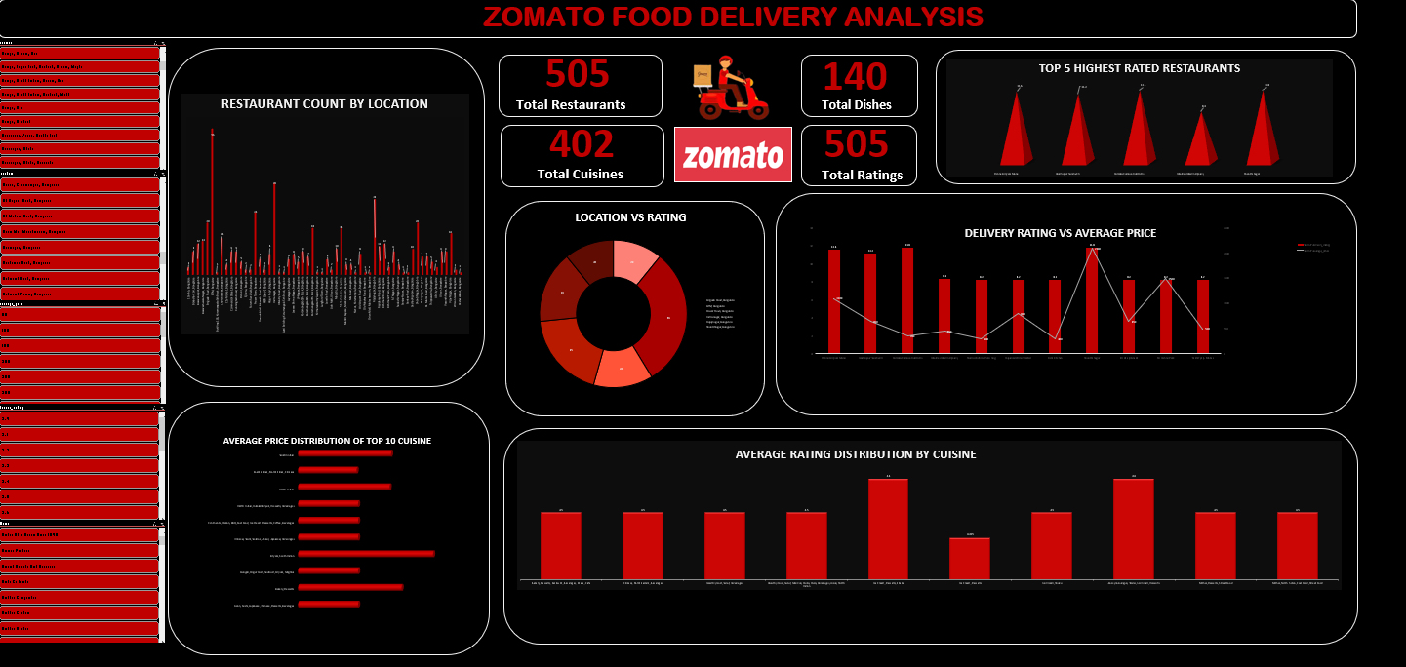
Project Insights
Dashboard

Slide 14
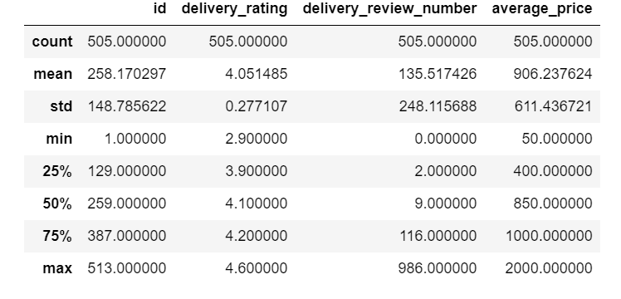
Project Insights
Inferences: 1.The average rating of all the restaurants is 4.05 2.The average cost in any restaurant is 906.23 3.The rating of restaurants ranges from a lowest of 2.9 to a highest of 4.6 4.The approximate cost ranges from a lowest of 50 to a highest of 2000

Slide 15
KEY FINDINGS SUMMARY
Top-Rated Restaurants: Kolkata Famous Kati Rolls and Shanthi Sagar shine with a delivery rating of 11.8.
Average Price Distribution: Biryani leads with an average price of 4500, followed closely by Bakery and Desserts at 3450.
Location Analysis: BTM, Bangalore, hosts 56 less-rated restaurants, suggesting customers may need to be more selective.

Slide 16
POTENTIAL FUTURE DIRECTIONS
Quality Boost: We can enhance food quality, speed up deliveries, and elevate service for exceptional experiences.
Pricing Optimization: We can analyze prices with customer feedback to stay competitive and value-driven.
Expansion Exploration: We can explore new territories to expand our customer base and reach.
Feedback Analysis: We can review feedback to pinpoint strengths and areas for improvement.
Collaboration Opportunities: We can partner with delivery platforms and suppliers to enrich our offerings and provide added value.

Slide 17
THANK YOU!

